Slide 1
Understanding Classical Music with Machine Learning
Ayanav Roy and Xander Uyttendaele

Slide 2

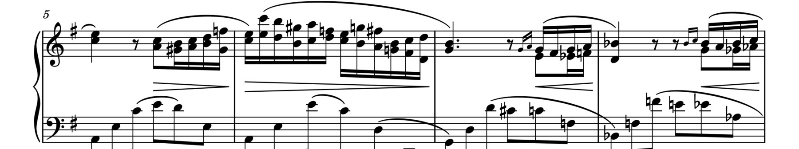
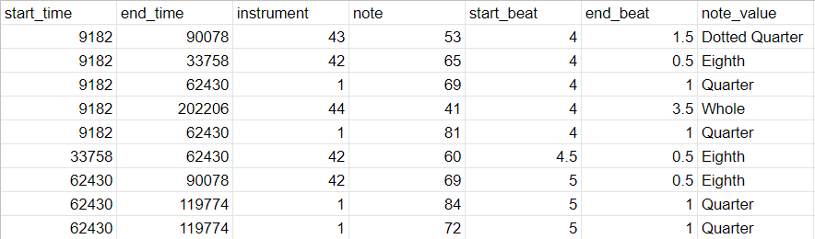
The Musicnet Dataset

Slide 3
Pitch Recognition: Problem Formulation
Segment audio into ⅓-second audio clips
128-dimensional label vector, with note present if playing at center of clip
Multiclass, multi-label
320 songs in training set, 10 songs in test set (326,580 clips in training set)
Evaluation: Compute per-note precision, recall, AUC on test set

Slide 4
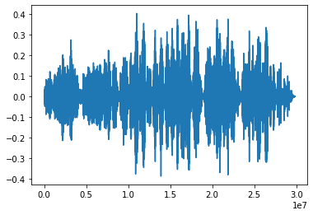
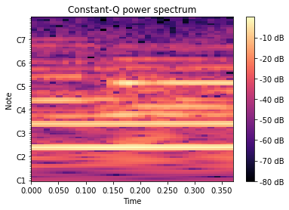
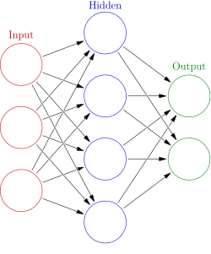
Basic Methodology

Slide 5
Traditional Methods
Baseline: choose rows of CQT with total energy above a threshold
Middle C precision: 41%, recall: 31%, AUC: 0.82
Logistic regression on raw audio
Doesn’t work :(
Logistic Regression on CQT:
Avg. precision: 39%, avg. recall: 70%, AUC: 0.929
No overfitting on test set observed (even without regularization)
CNN on CQT:
Avg. precision: 52%, avg. recall: 72%, AUC: 0.9596
RNN on CQT:
Remains to be done

Slide 6
PCA!
On raw audio, interesting “eigenaudios,” but no success with semi-supervised learning.
On CQT-transformed data, semi-supervised learning slightly outperforms logistic regression (on only 128 principal components)!
Middle C precision: 70.0%, recall: 41%, AUC: 94.2% (overall AUC: 93.6%)
“eigen-CQT”s less illuminating

Slide 7
Much More to Do
Instrument Classification/Separation
Note Prediction (given previous notes)
Music Generation
Composer Detection
Key Signature Detection
and more!

